Slide 1
Instructions to use Nanotrons
Kelly Lab

Slide 2
Main points
Slides #
Nanotrons app ------------------- 3 - 7
Robot setup ----------------------- 8 -
Protocol structure ---------------
Robot-App interface ------------
Creating a protocol -------------
Creating Labware ---------------
Running a protocol -------------
Making Changes ----------------

Slide 3
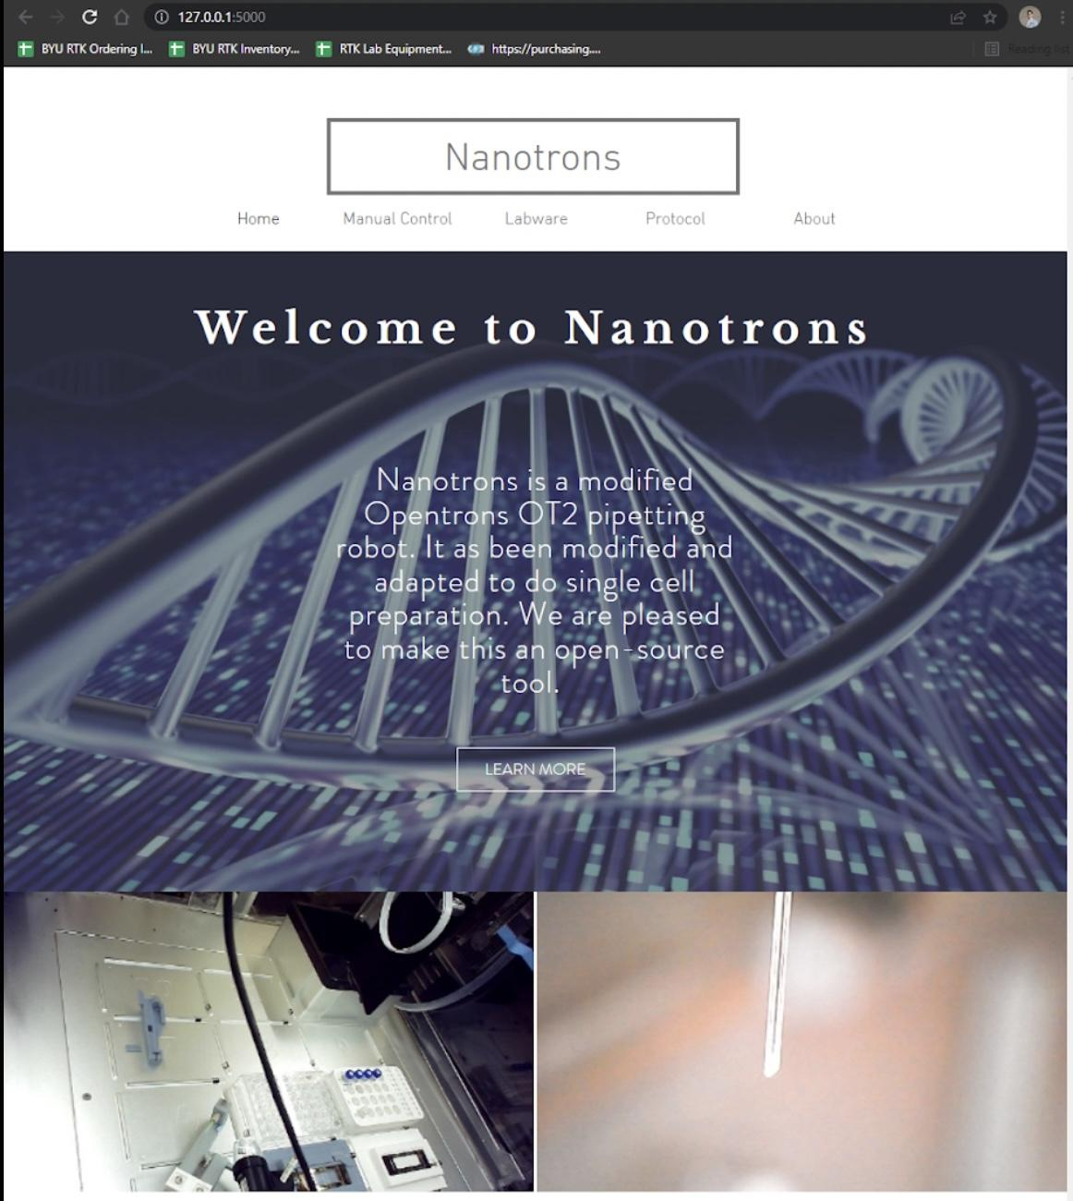
Nanotrons app
The home page contains:
Tabs to navigate throughout the app
Small description of the project
Link to Nanotrons video
Syringe view
Robot view

Slide 4
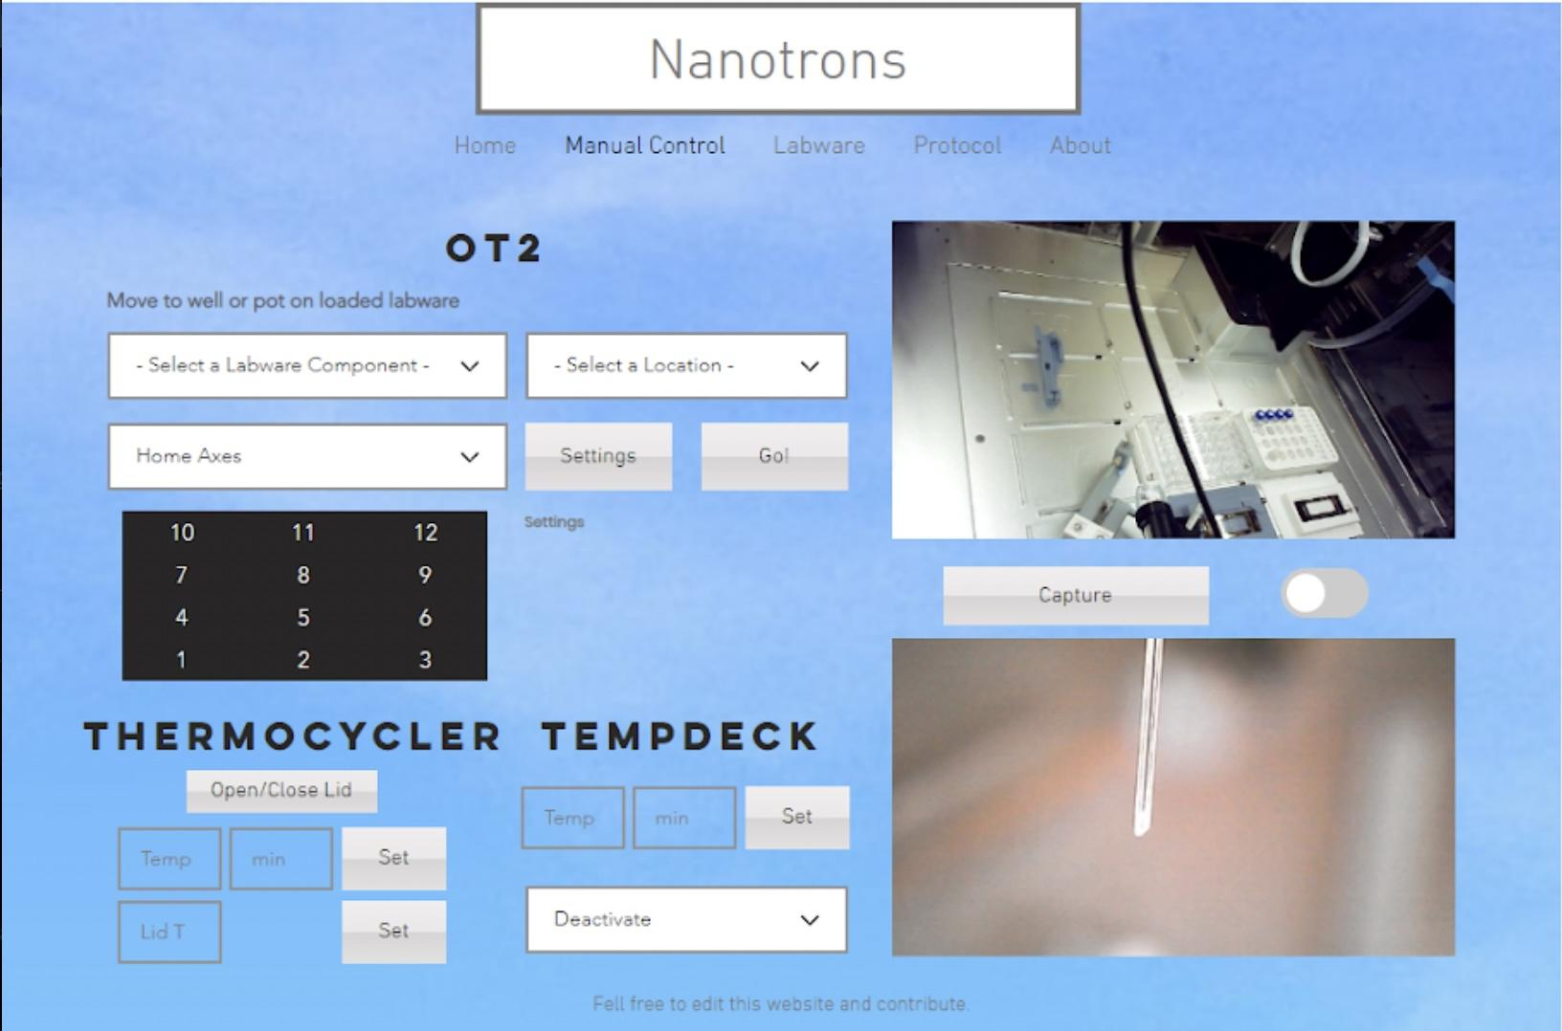
Manual control page
Move syringe to a loaded labware location
Settings: current coordinates, side controlling, nanoliters picking up
Move to slot section. Press a number to move the pipette to that slot.
Thermocycler Tº control
Tempdeck Tº control
*Requires an xbox controller

Slide 5
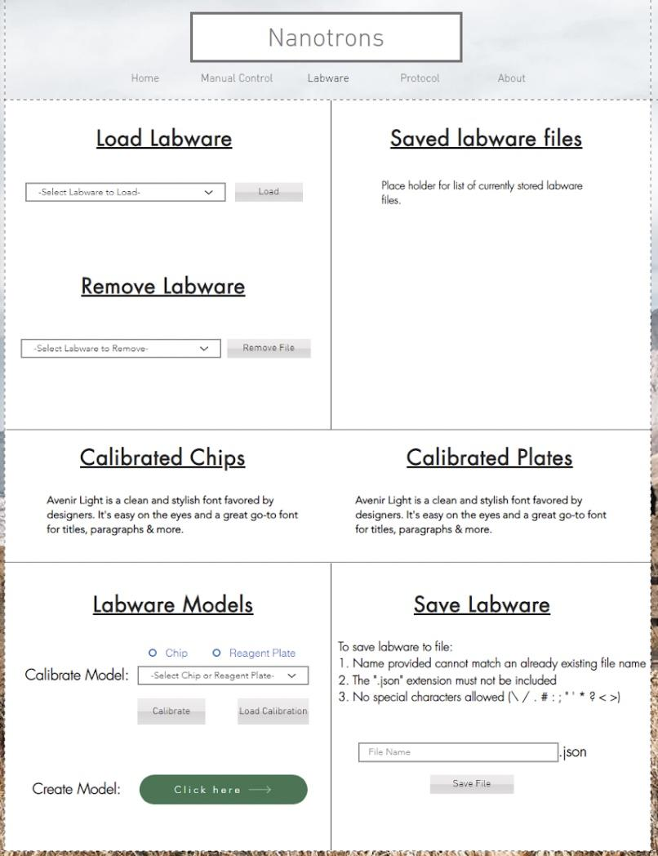
Labware page
Load labware: select a .json file from the saved_labware folder. This loads the well and pot locations for each labware as a dictionary. Use manual control to be able to check calibration.
Currently stored labware files: shows what files are in the saved_labware folder.
Calibrated Chips: shows the currently loaded chips.
Calibrated Plates: shows the currently loaded plates.
Labware models:
Calibrate models: Allows you to add and calibrate a chip or a plate. See calibration instructions for more information.
Create model: Allows to to create a template for future calibrations.
Save Labware: save loaded labware into a new json file to use in your protocols.

Slide 6
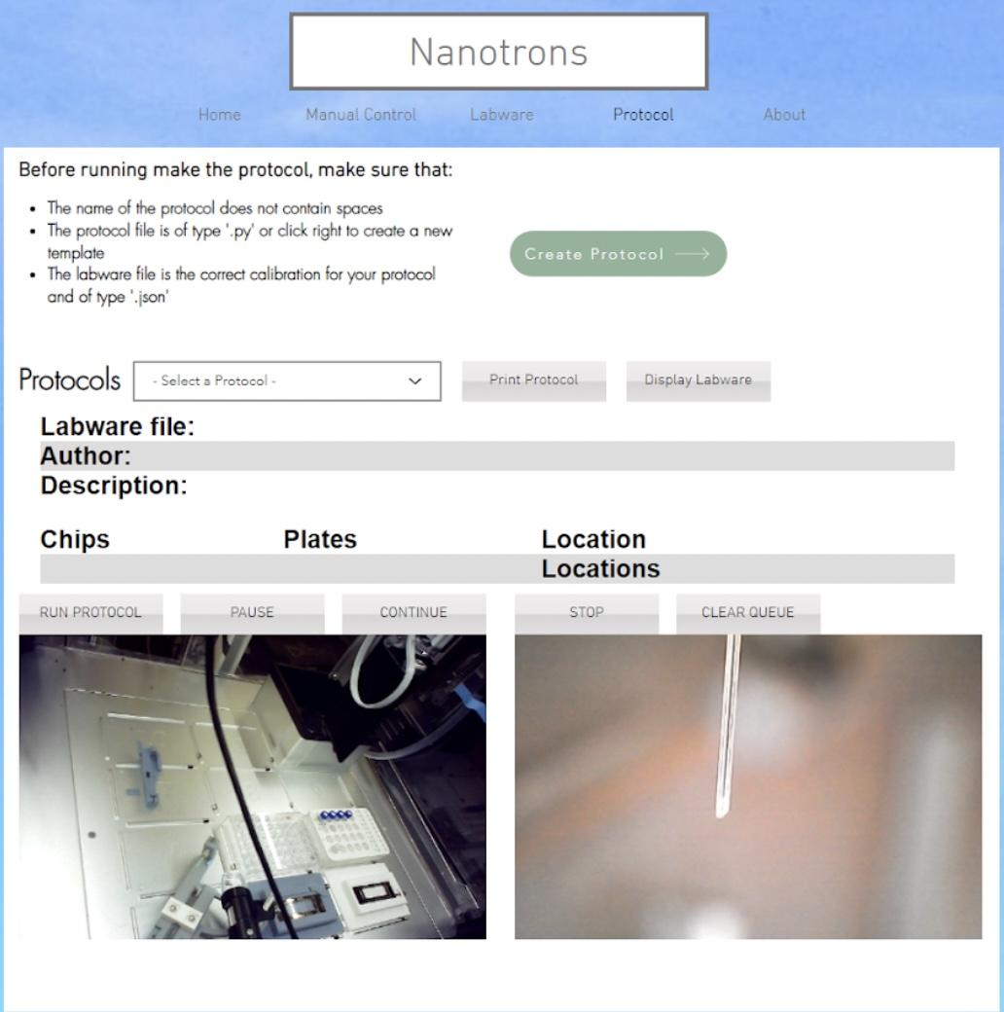
Protocol page
Instructions regarding protocol names. Critical for a subprocess execution.
Dropdown with a list of available protocols.
Print protocol: Shows the contents of the .py file. Allows you to quickly check if the protocol is correct. For edition use an python IDE. (Visual Studio Code)
Display labware: shows where the labware for the selected protocol should be placed
Loaded labware
Buttons to run, pause, continue and stop protocol execution.
Image of the cameras.

Slide 7
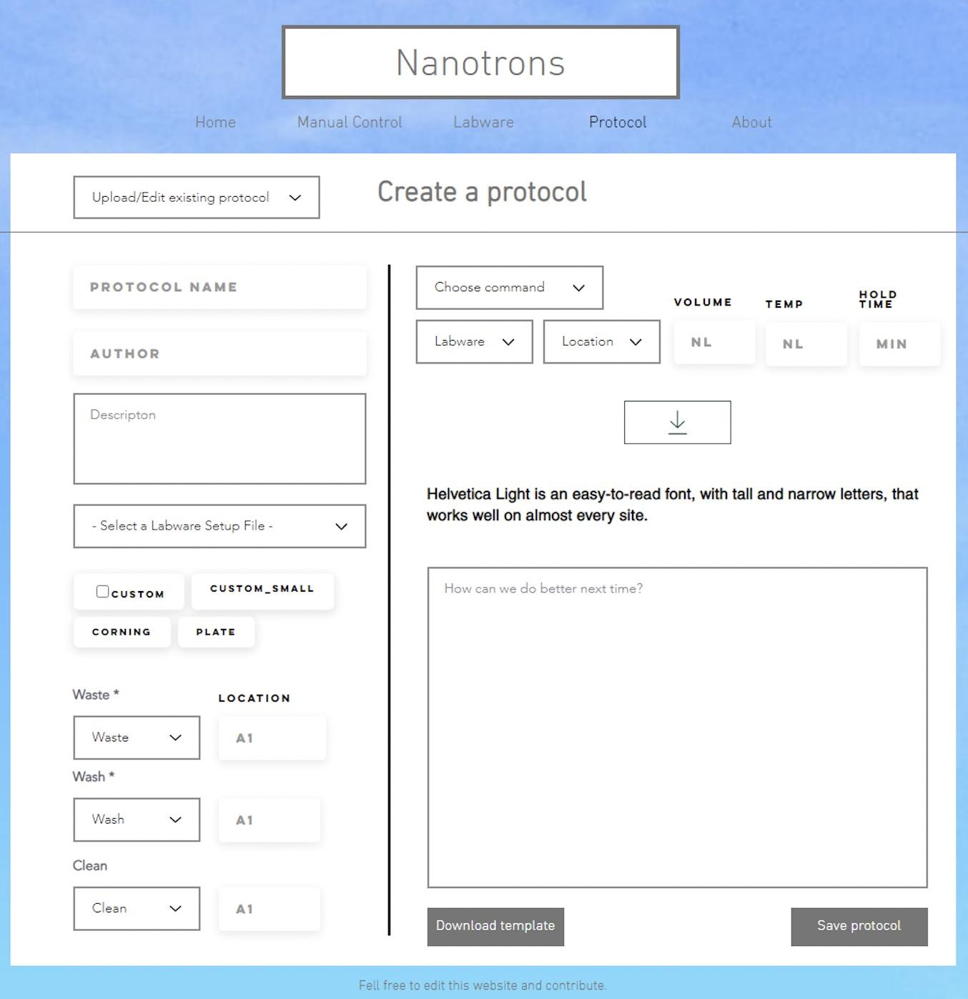
Protocol edition page
Upload a file you might want to edit
Protocol name
Author
Description
Labware file: calibrated labware in a json format in saved_labware folder.
Available plates from the file
Waste, wash and clean pot position in labware.
Command creator: This serves as a template for commands that the user wants to add to the protocol. It might be necessary to use an ide for very long protocols.

Slide 8
Robot set up
RasPi - Debug mode switch
Settle time
Opentrons app homing
Installing the P20 pipette
Installing 3D printed syringe mount
Installing Camera

Slide 9
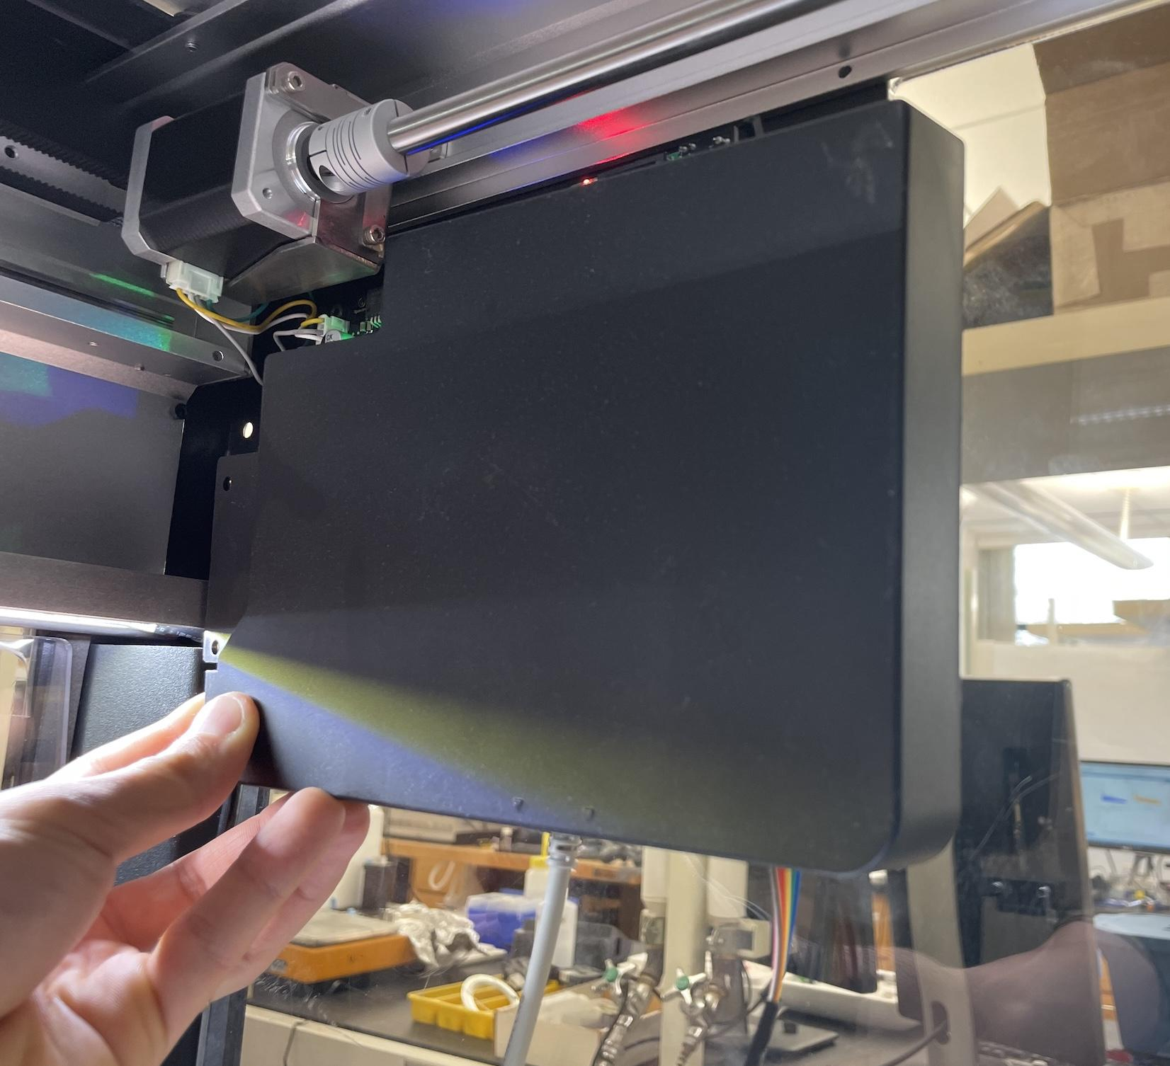
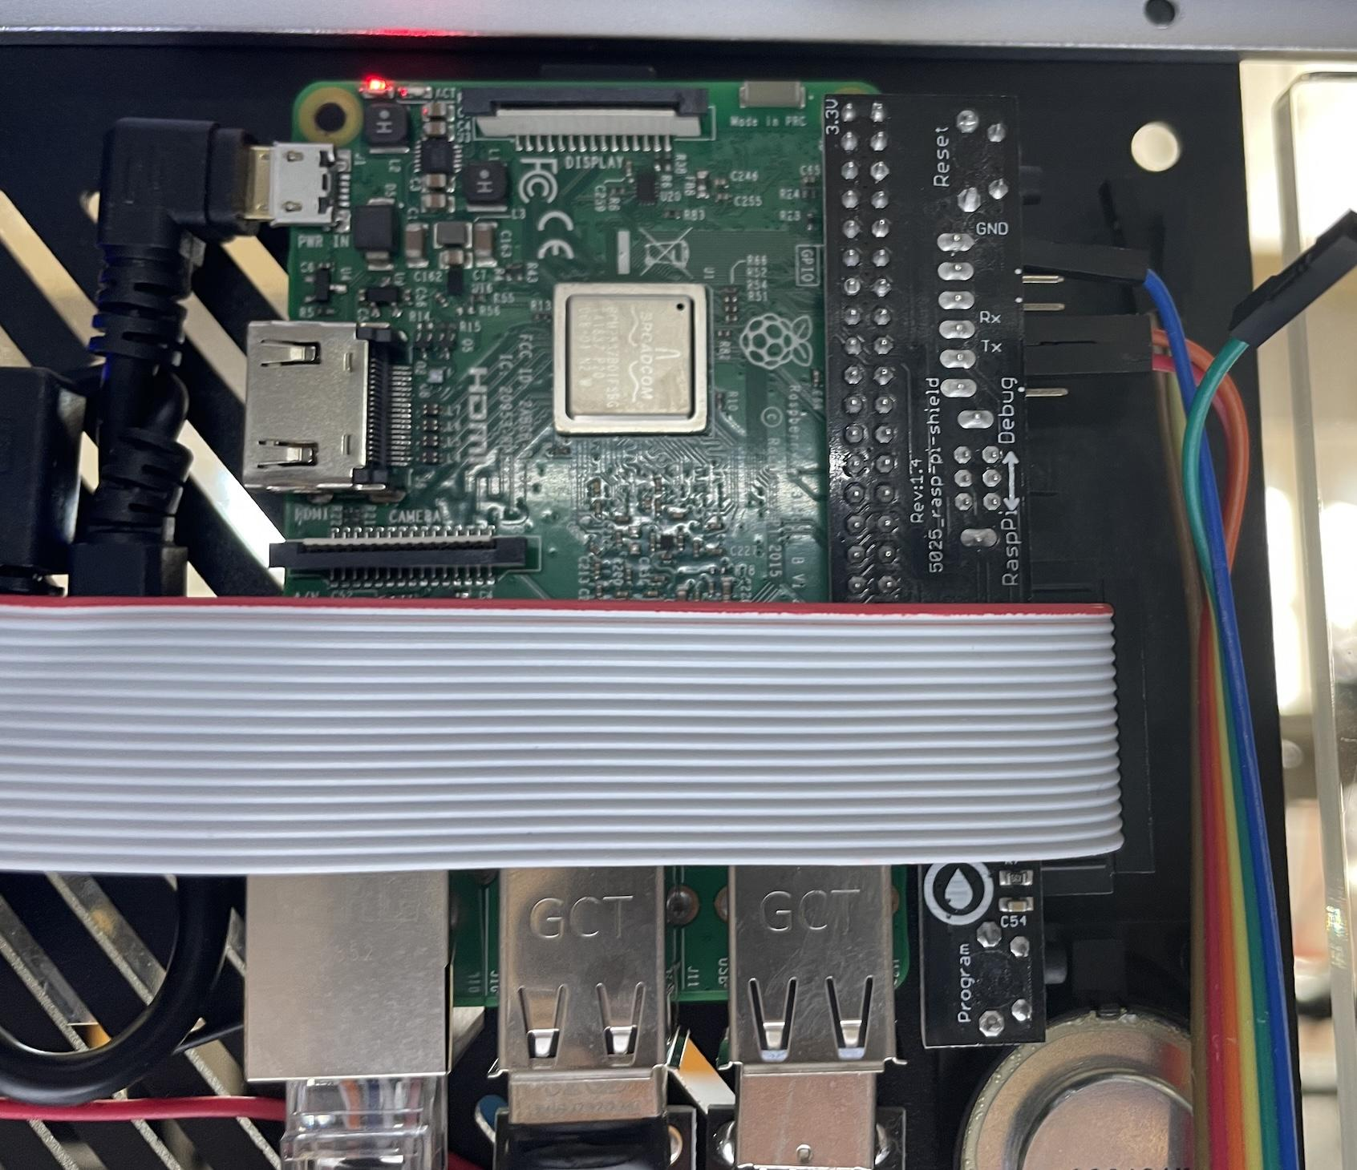
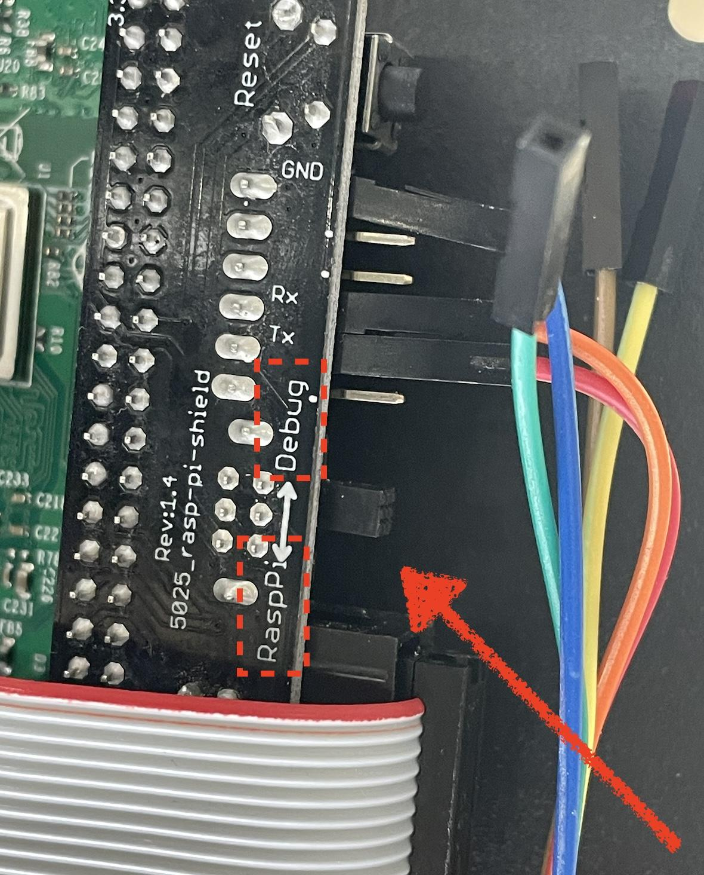
RasPi - Debug mode switch
Before turning the robot on:
Remove the back panel to be able to access the Raspberry Pi (RasPi) board
Make sure the switch is in RasPi mode
The RasPi board is the interface for the Opentrons app to the Smoothie Motor driver board.
In order for the Nanotrons app to connect serially to the Smoothieboard, we need to move the switch to the Debug Mode in the Raspi Shield after the robot has been started correctly (See Settle time slide) and homed properly by the Opentrons App.

Slide 10
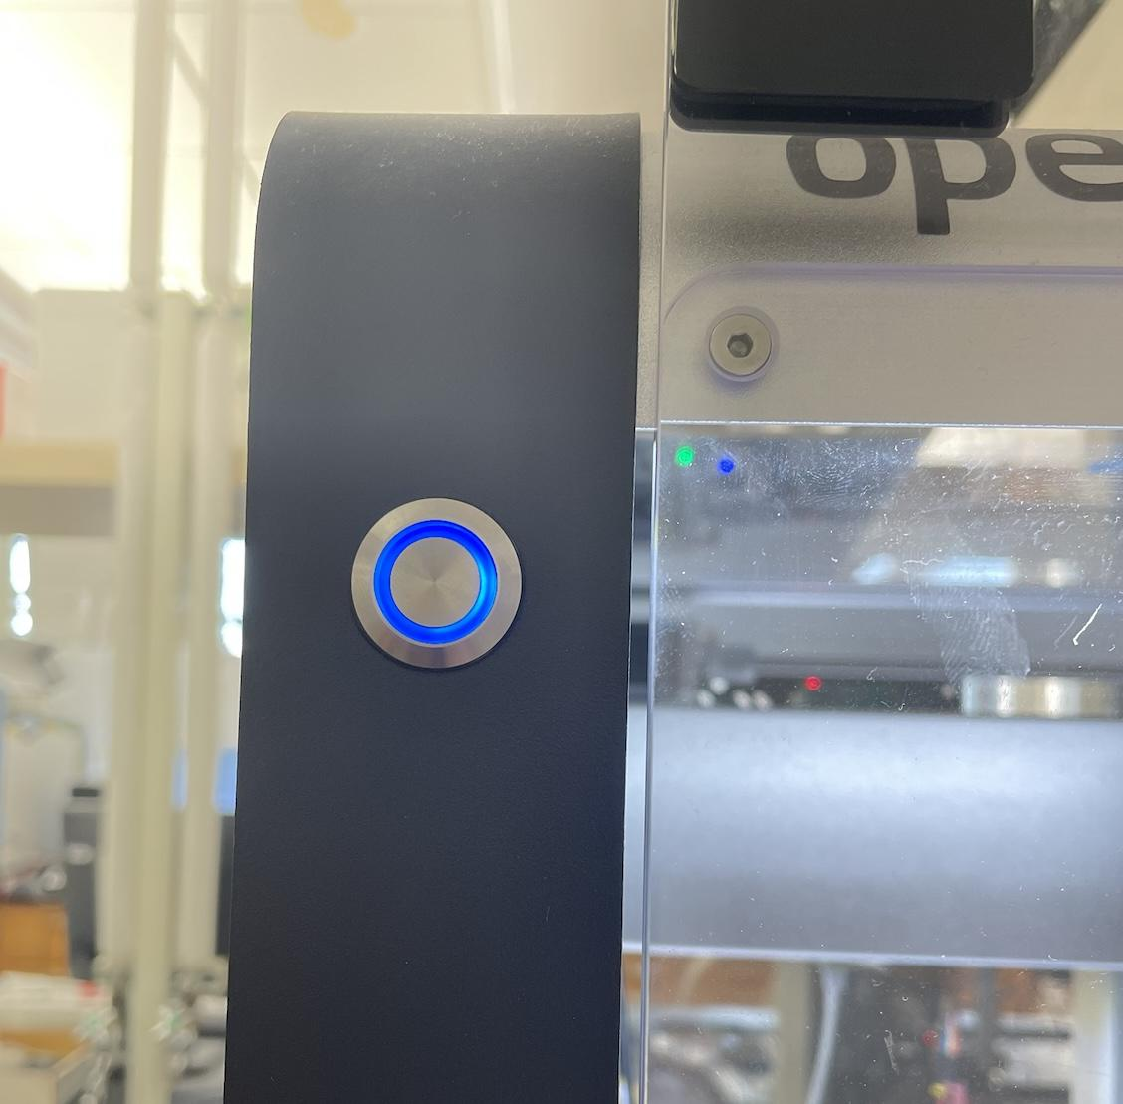
Opentrons settle time
Once the robot has been turned on:
Wait until the robot blue led button stops blinking (It might happen 2 or 3 times sometimes)
Wait until the axis make the home sound
This will take about a minute

Slide 11
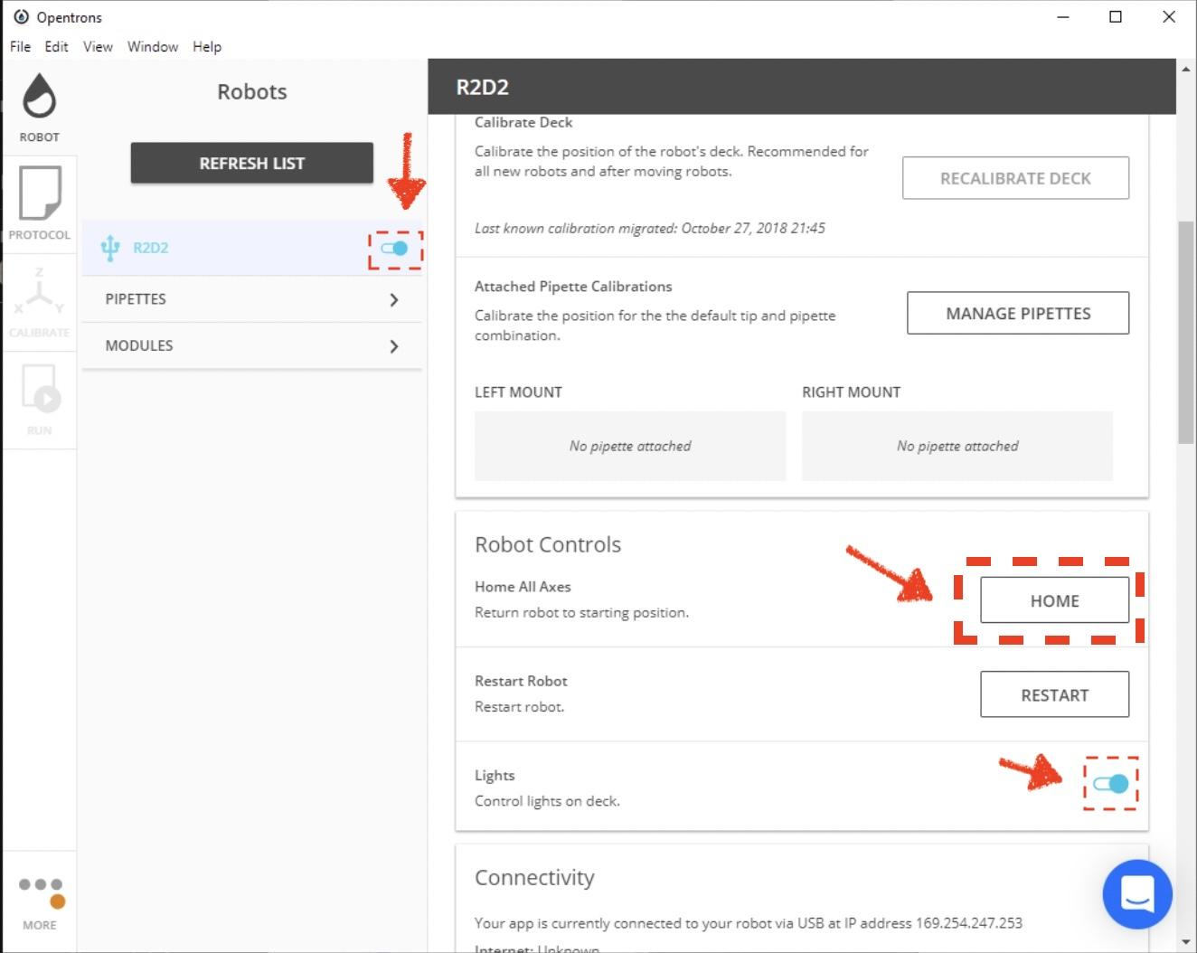
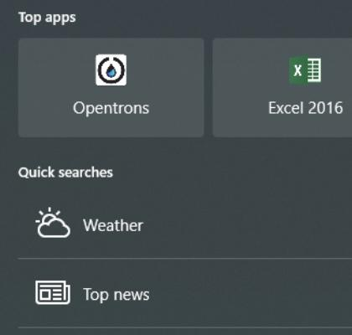
Opentrons App Homing
Open the Opentrons app
Connect to the robot
Press the home button
If preferred: turn on the lights.

Slide 12
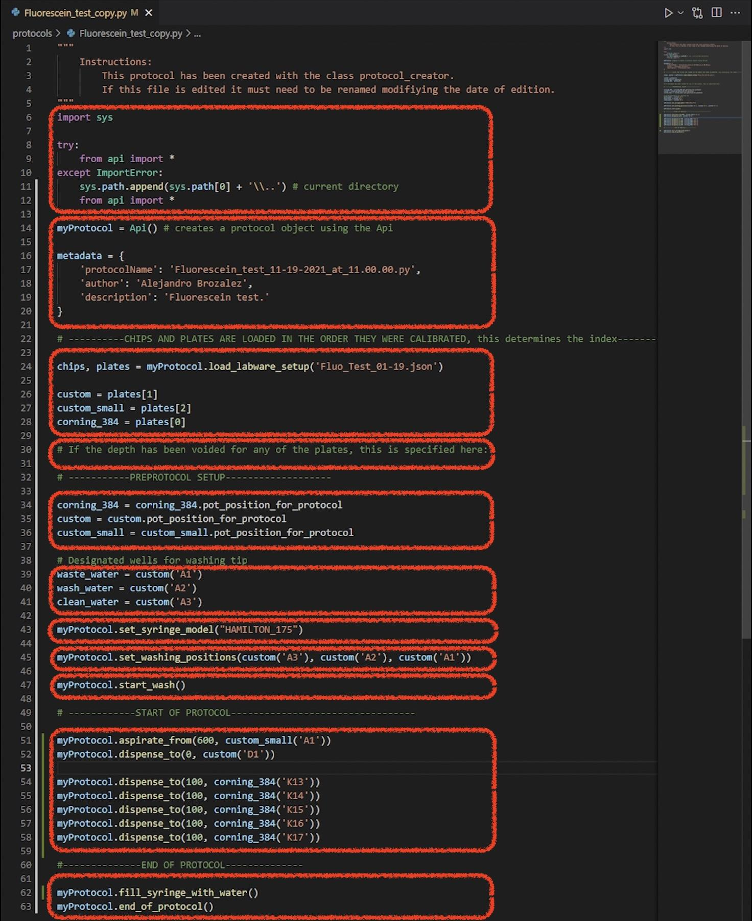
Nanotrons Protocol structure
We use a python class named Protocol creator to be able to create a protocol with some inputs like the author, labware file, description, commands, etc. This is done in the create protocol page. When downloading the protocol, it will be saved in the folder, and it has the following structure →

Slide 13
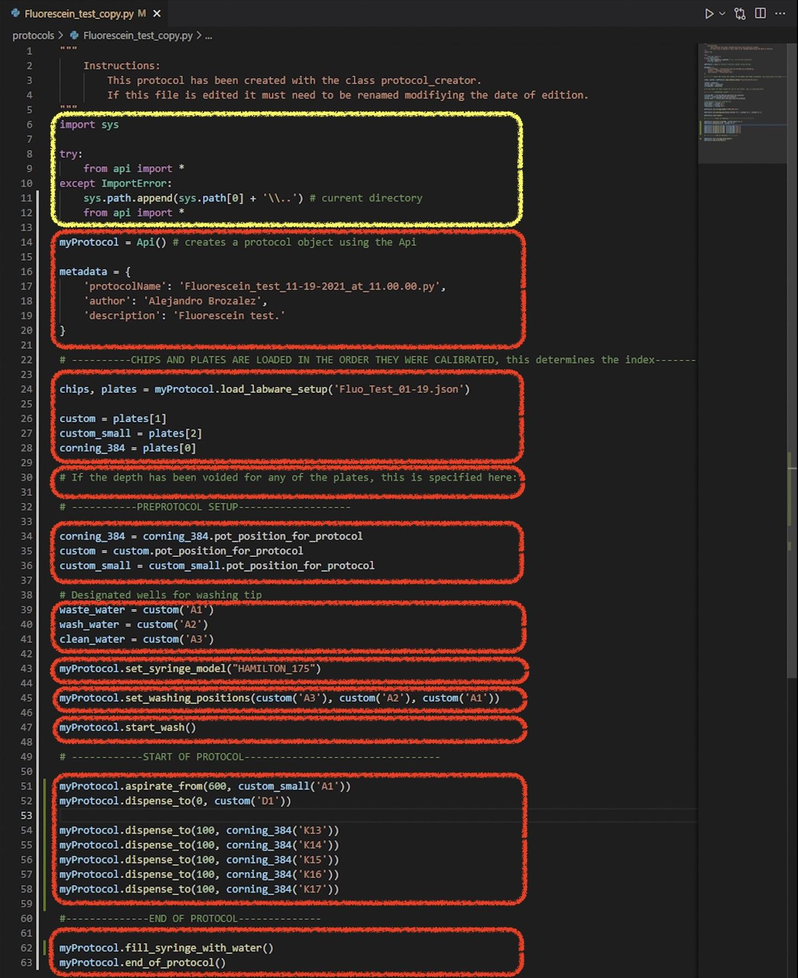
Importing section
This section import the class API. In case we are located in a different directory we append the previous directory so that it can access the API class in the api.py file.

Slide 14
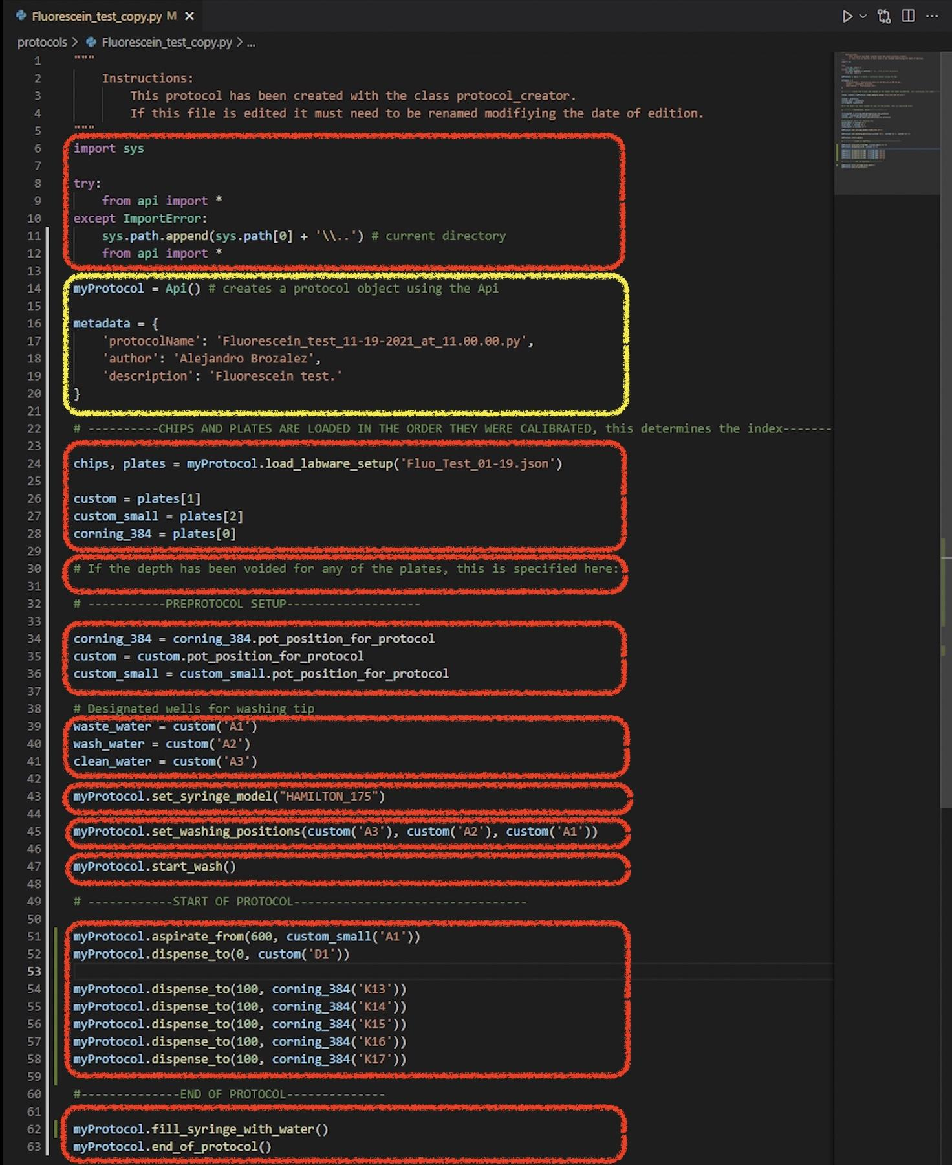
API object and metadata
We create an api object called my protocol (this name is arbitrary) which contains all the instructions that the robot can perform for the user. These functions are called in the START OF PROTOCOL section as:
myProtocol.<instruction>(<params>)
Metadata is not used for anything in the executer. This variable is recognized by the webapp when retrieving information about the protocol.

Slide 15
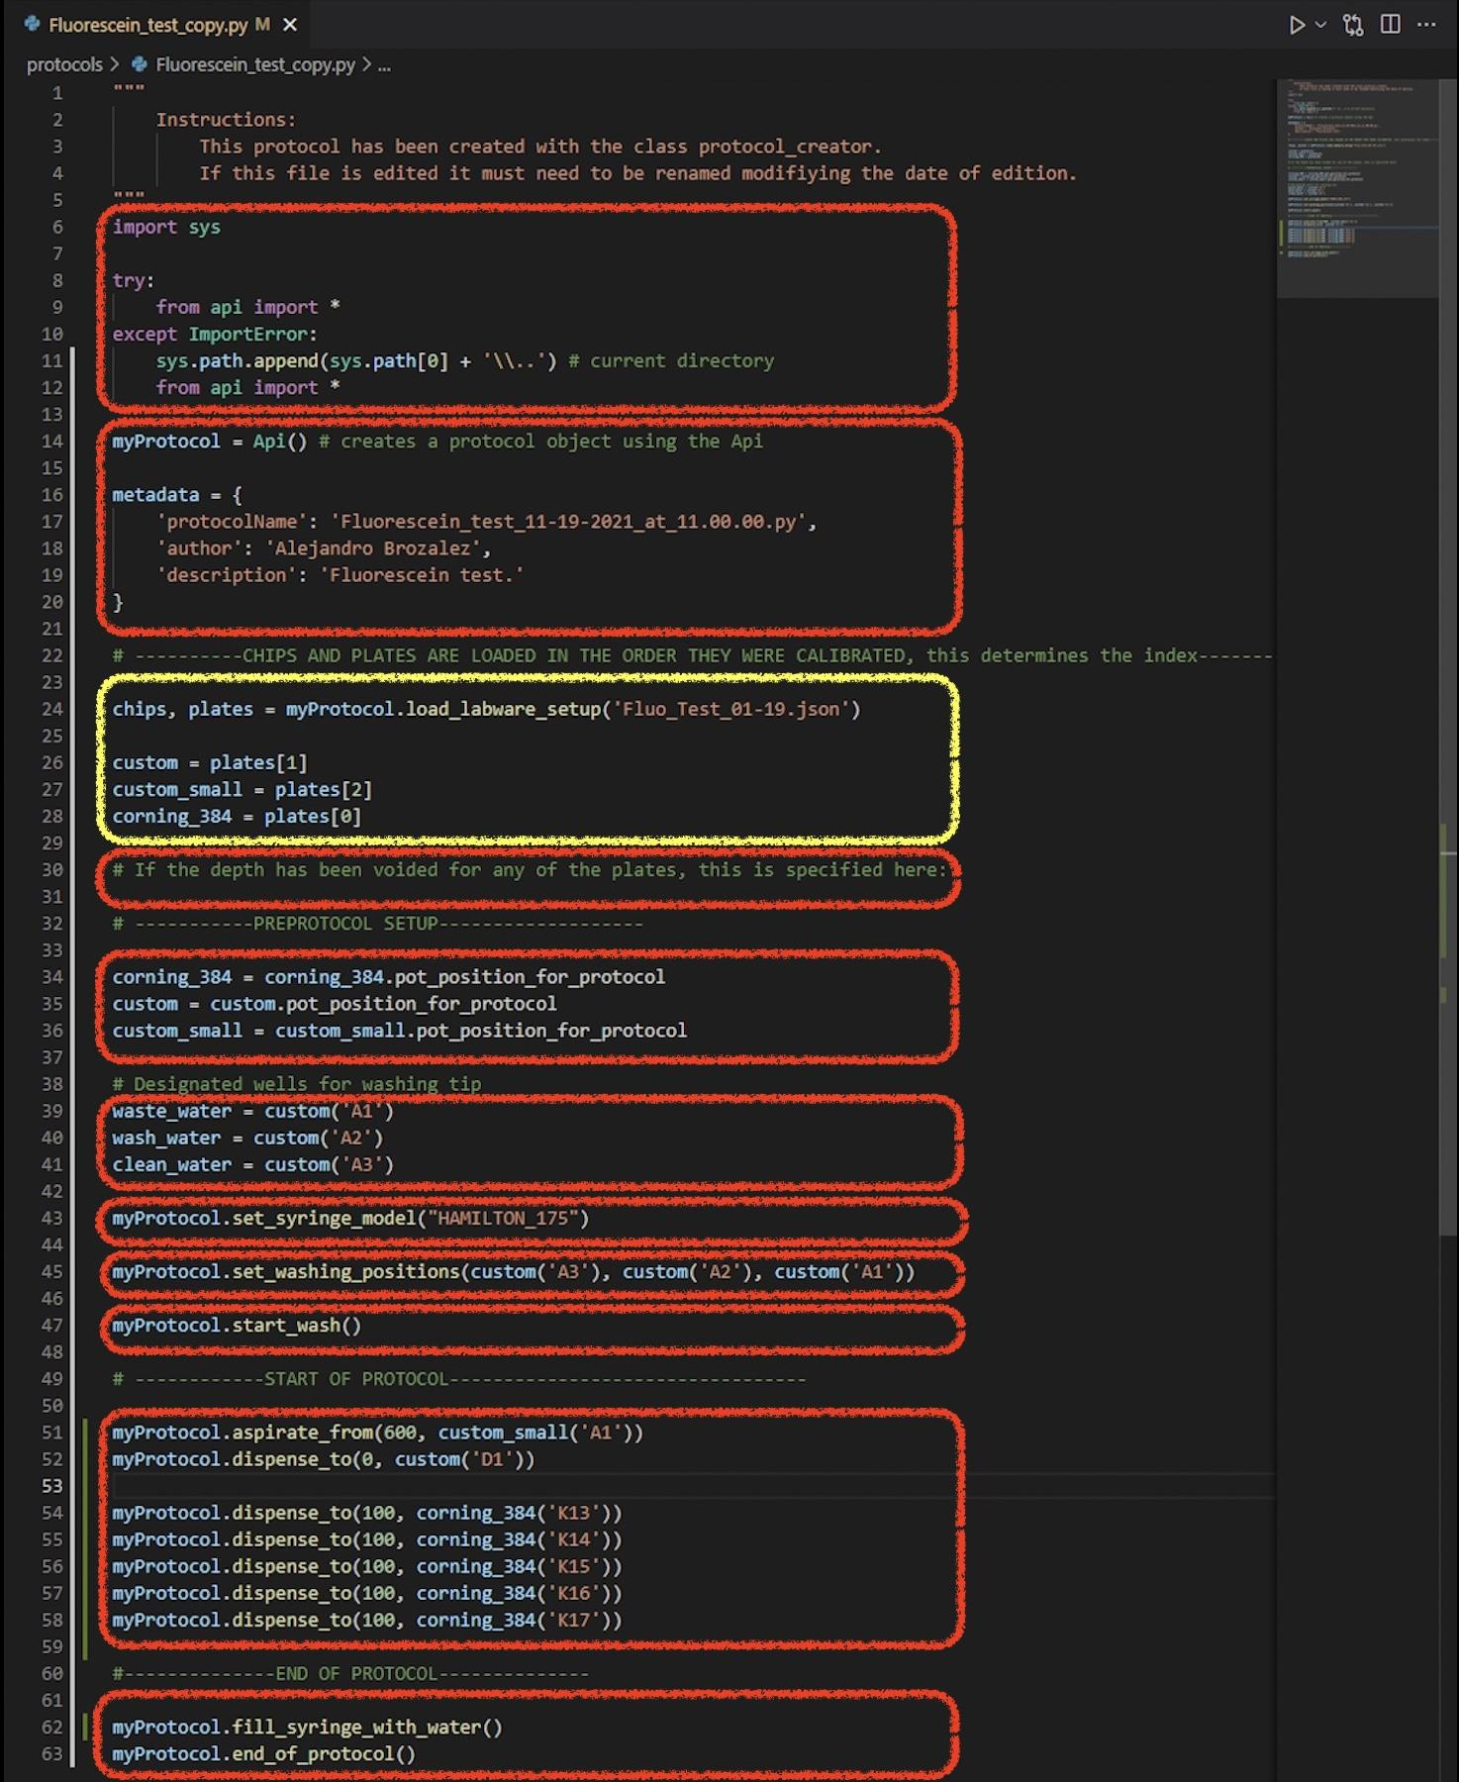
Labware definition
Labware from a .json file were added in the order they were calibrated. Then if there is more than one plate, this will be in a list datatype: plates[<index>]
**In this example we have 3 plates in this list. Corning_384 was calibrated first (plates[0]), then custom(plates[1]), then custom small(plates[2]).
The order is very important, because the api will access the labware locations registers in the .json file. If these are in the incorrect order the pipette could run into something and break.

Slide 16
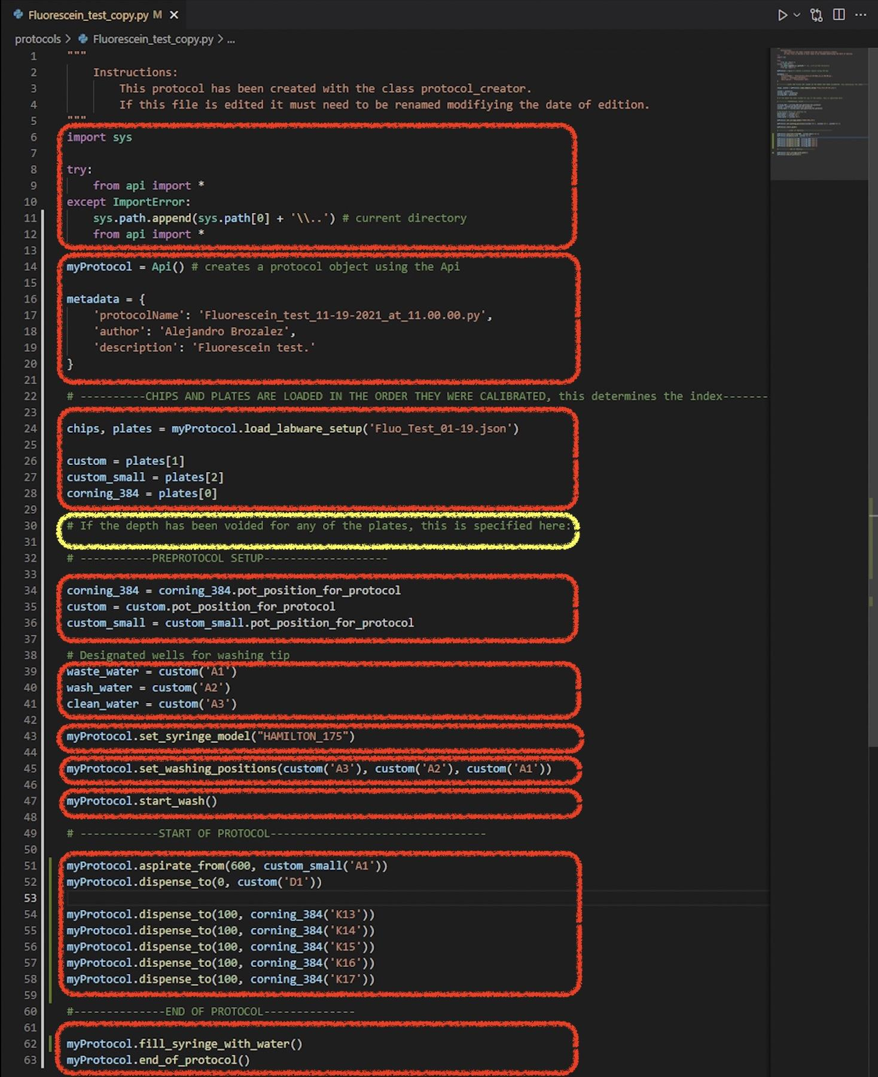
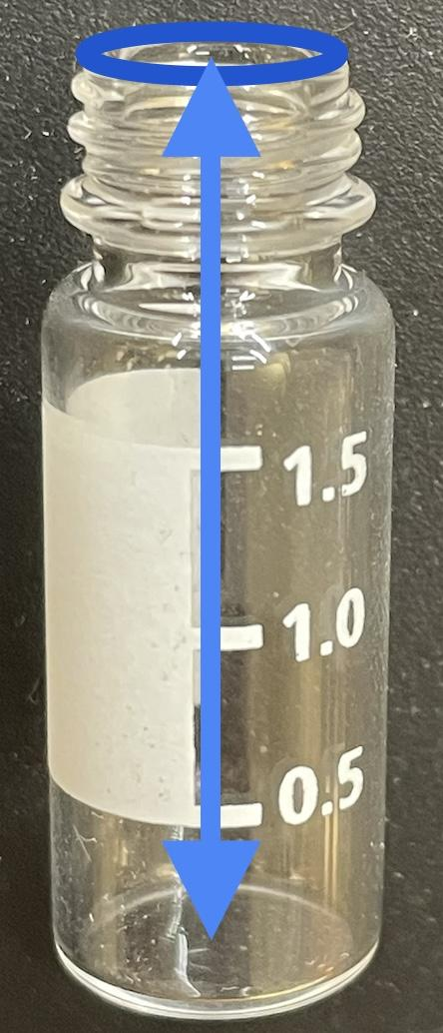
Depth of plates section
When plates are calibrated, we set the syringe right on the top of the pot. There is a variable in the model that indicated the depth of the pot. In this example it is 20mm. A chip does not have any depth. If the depth is voided, the syringe will not go into the pot by the depth specified. It will stop right on top.

Slide 17
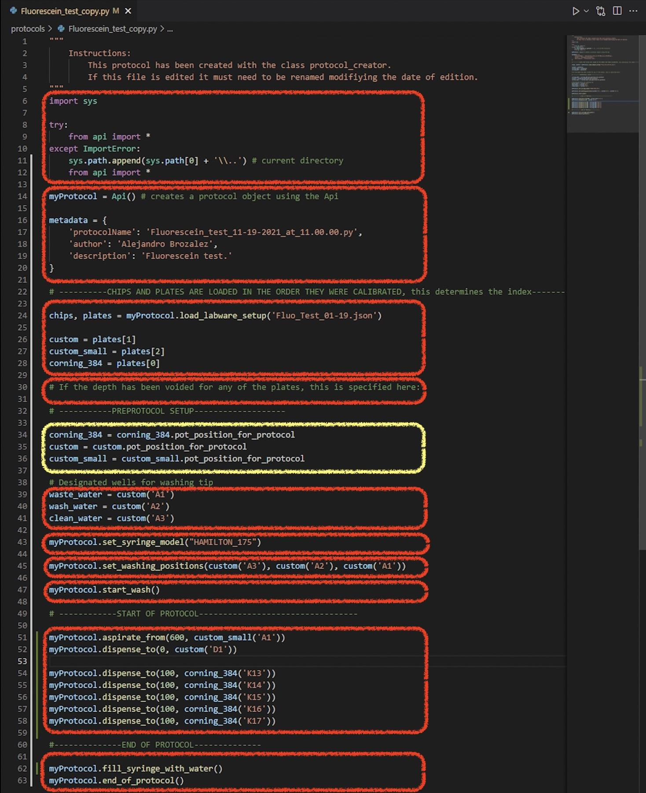
Protocol setup
A redefinition of the plates, so that we can input the positions without writing: “pot_position_for_protocol” every time we use a plate or chip.
<plate>=<object plate from list>.pot_position_for_protocol
Now we can call the plate we need and input the position as <plate>(<position>) or plate(“A1”)

Slide 18
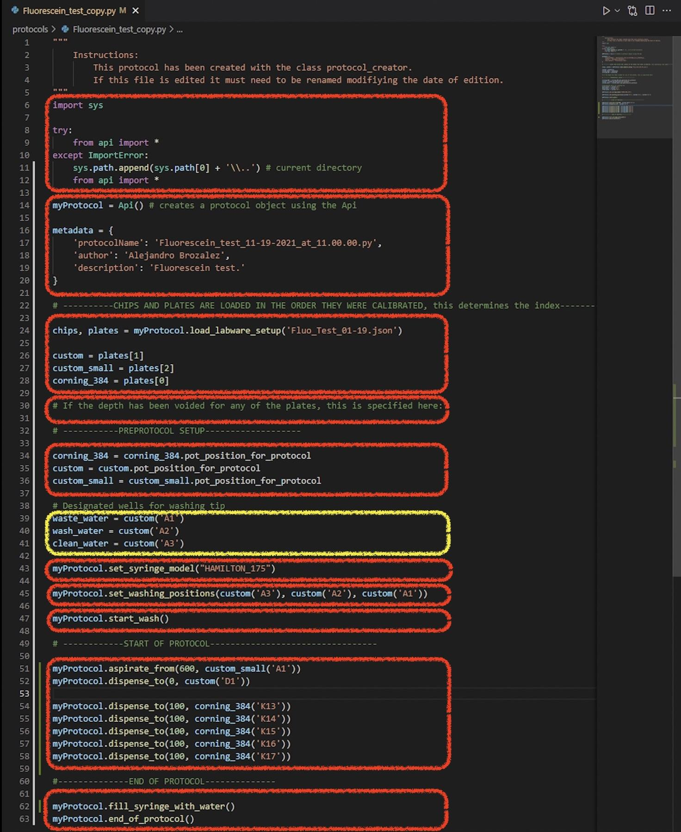
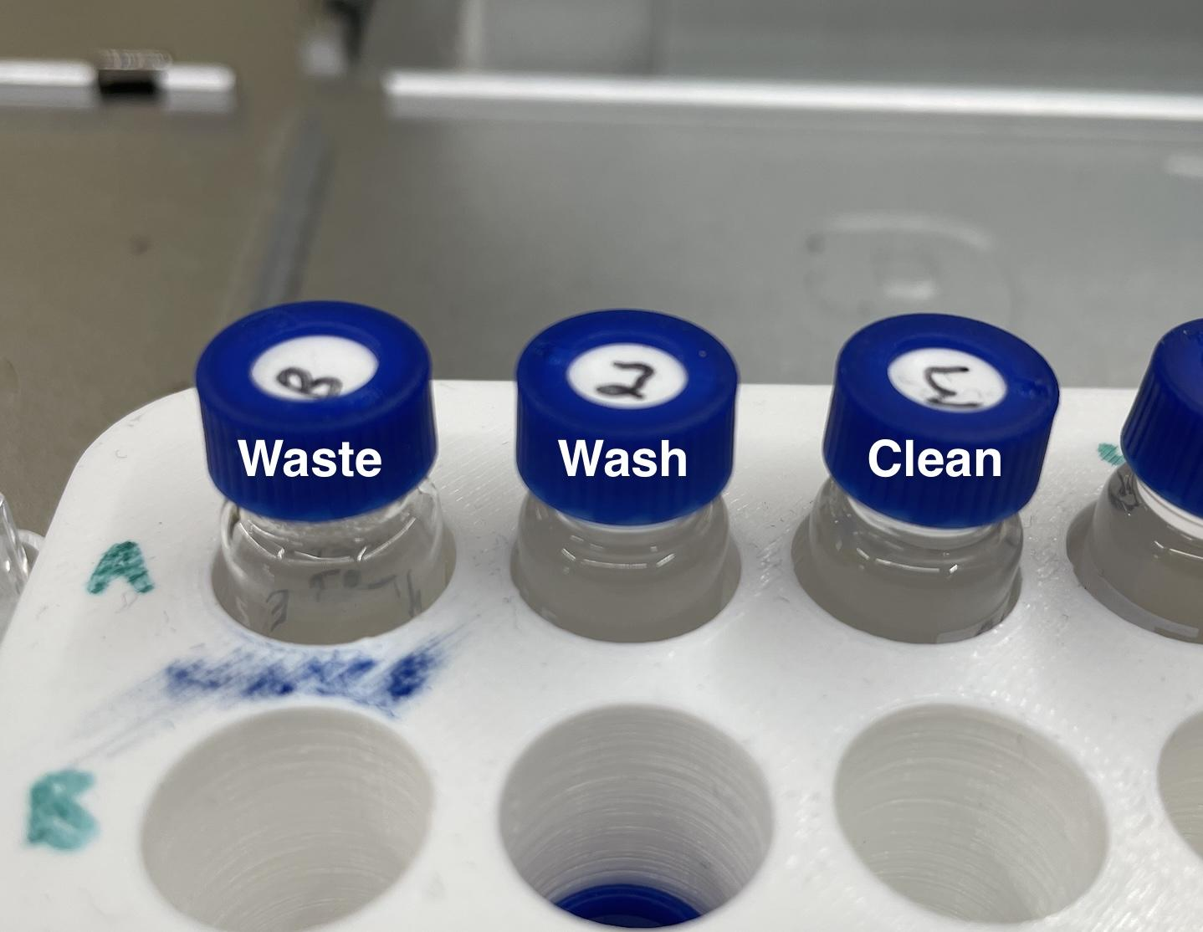
Locations for washing
This are the positions in which the pots are placed for the washing protocol.

Slide 19
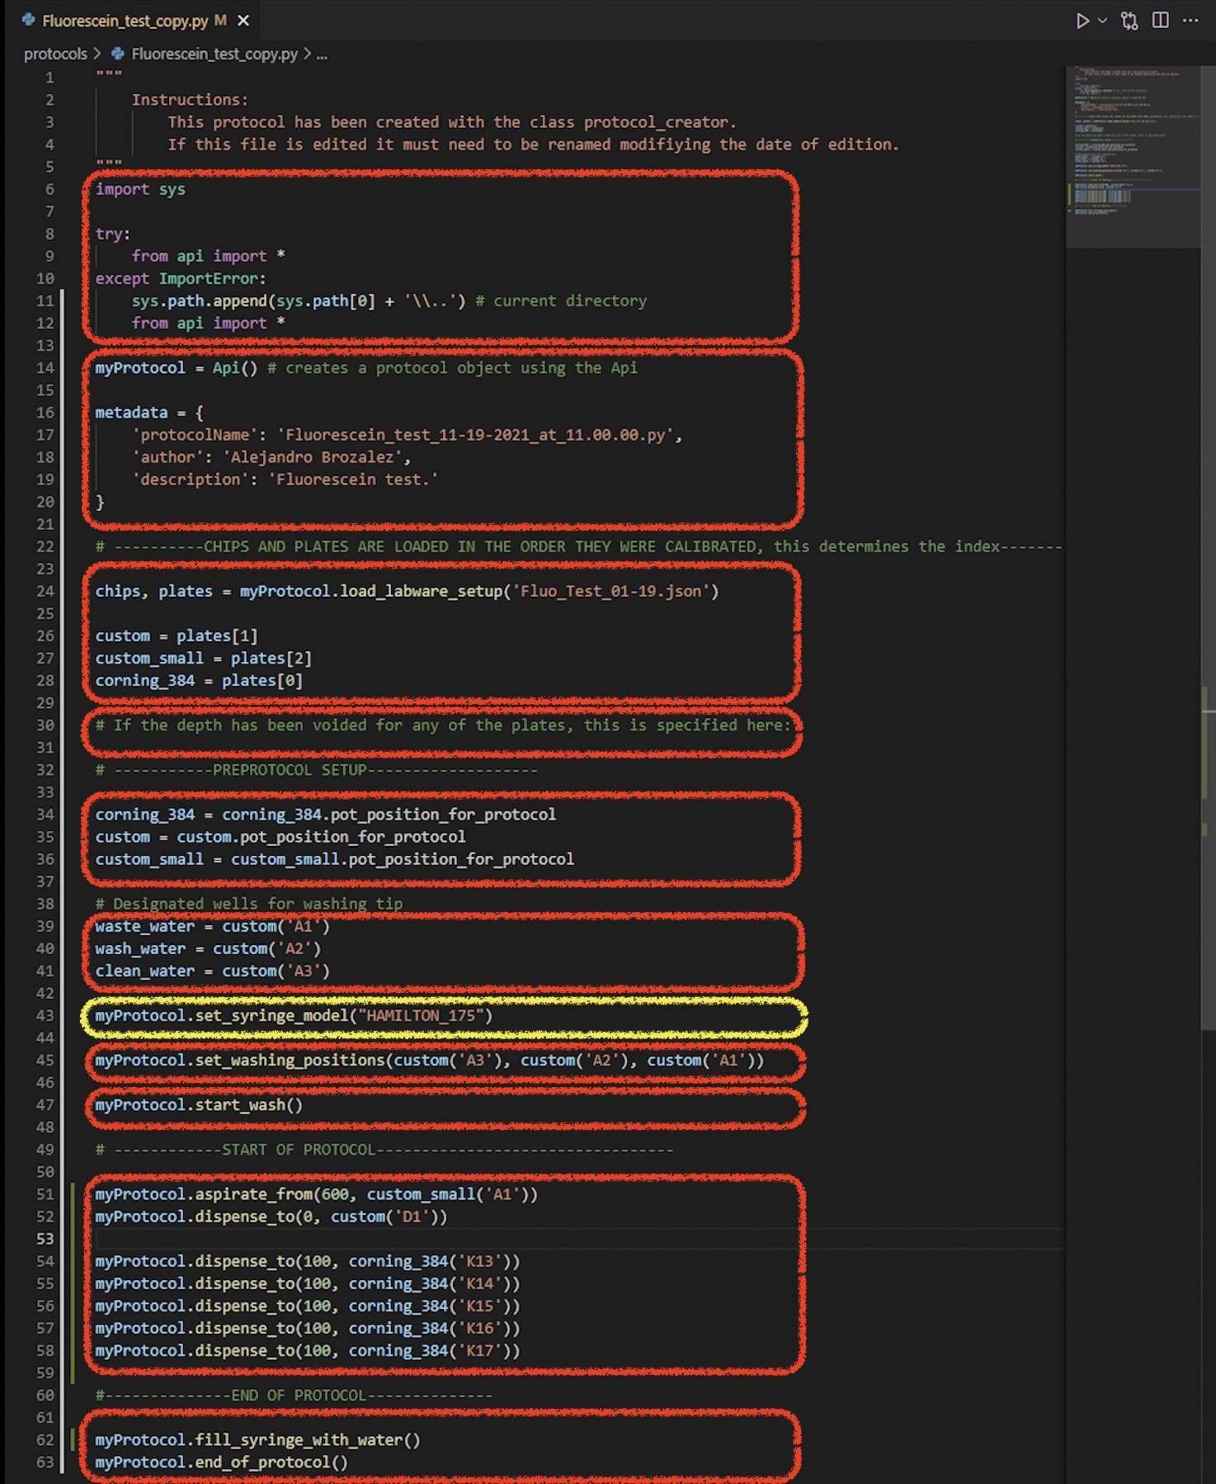
Setting the syringe model
Depending of the syringe we are using there are different configurations.

Slide 20
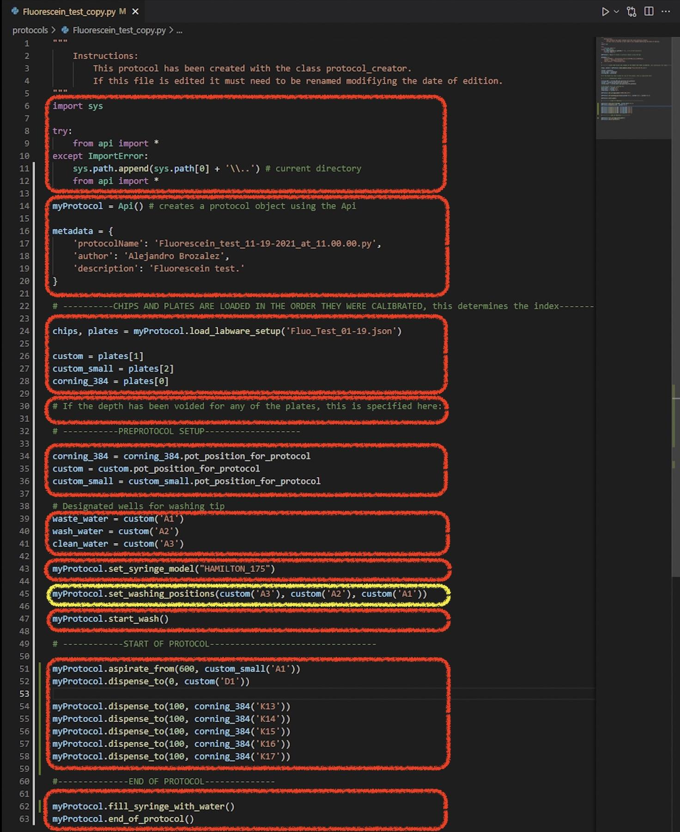
Set washing position in api
Import the locations to the api for the washing positions

Slide 21
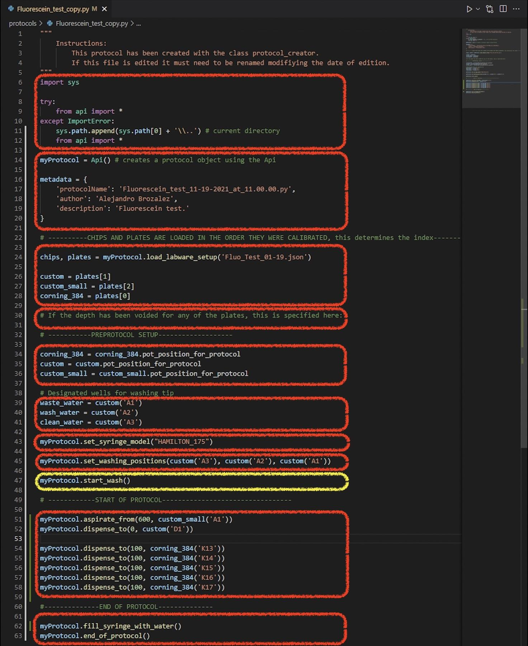
Start wash protocol
This step washed the syringe at the beginning of the protocol in the following steps:
Go to waste and drop all the liquid in the syringe.
Go to wash and aspirate then drop water to rinse the syringe.
Go to clean water and absorb water until about half of the syringe

Slide 22
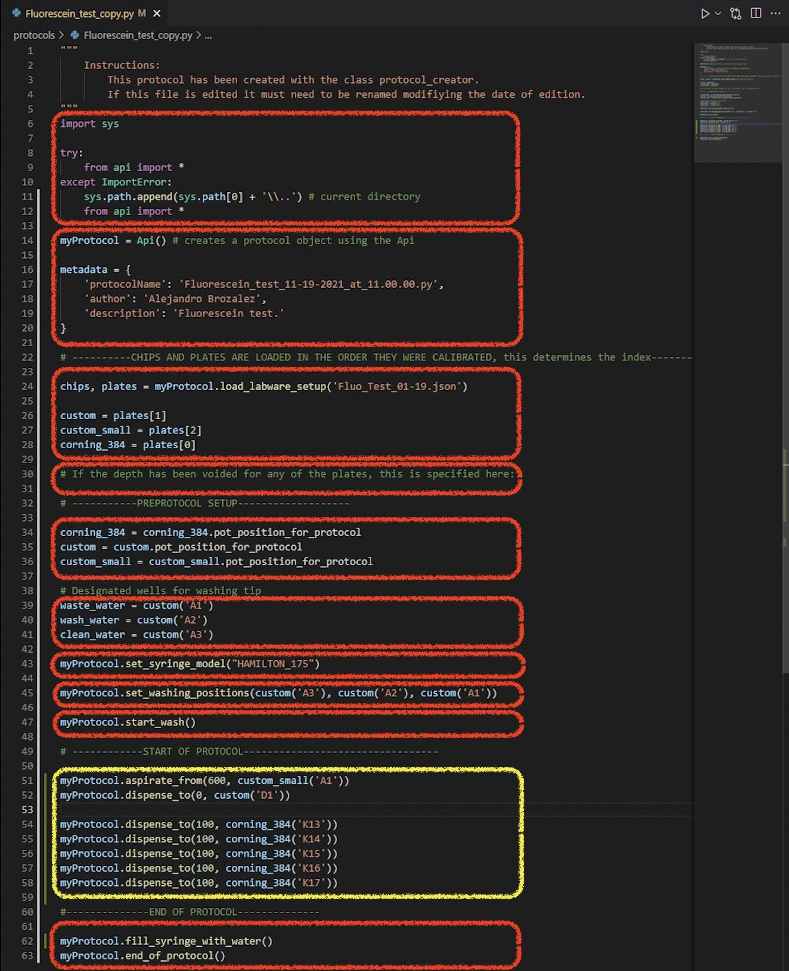
Protocol instructions
This is section contains the instructions for the protocols. It can do as many as needed. If there is a basic knowledge of python, “for” loops could be implemented to repeat a large set of instructions. It is easier to edit this section in an IDE like visual studio.

Slide 23
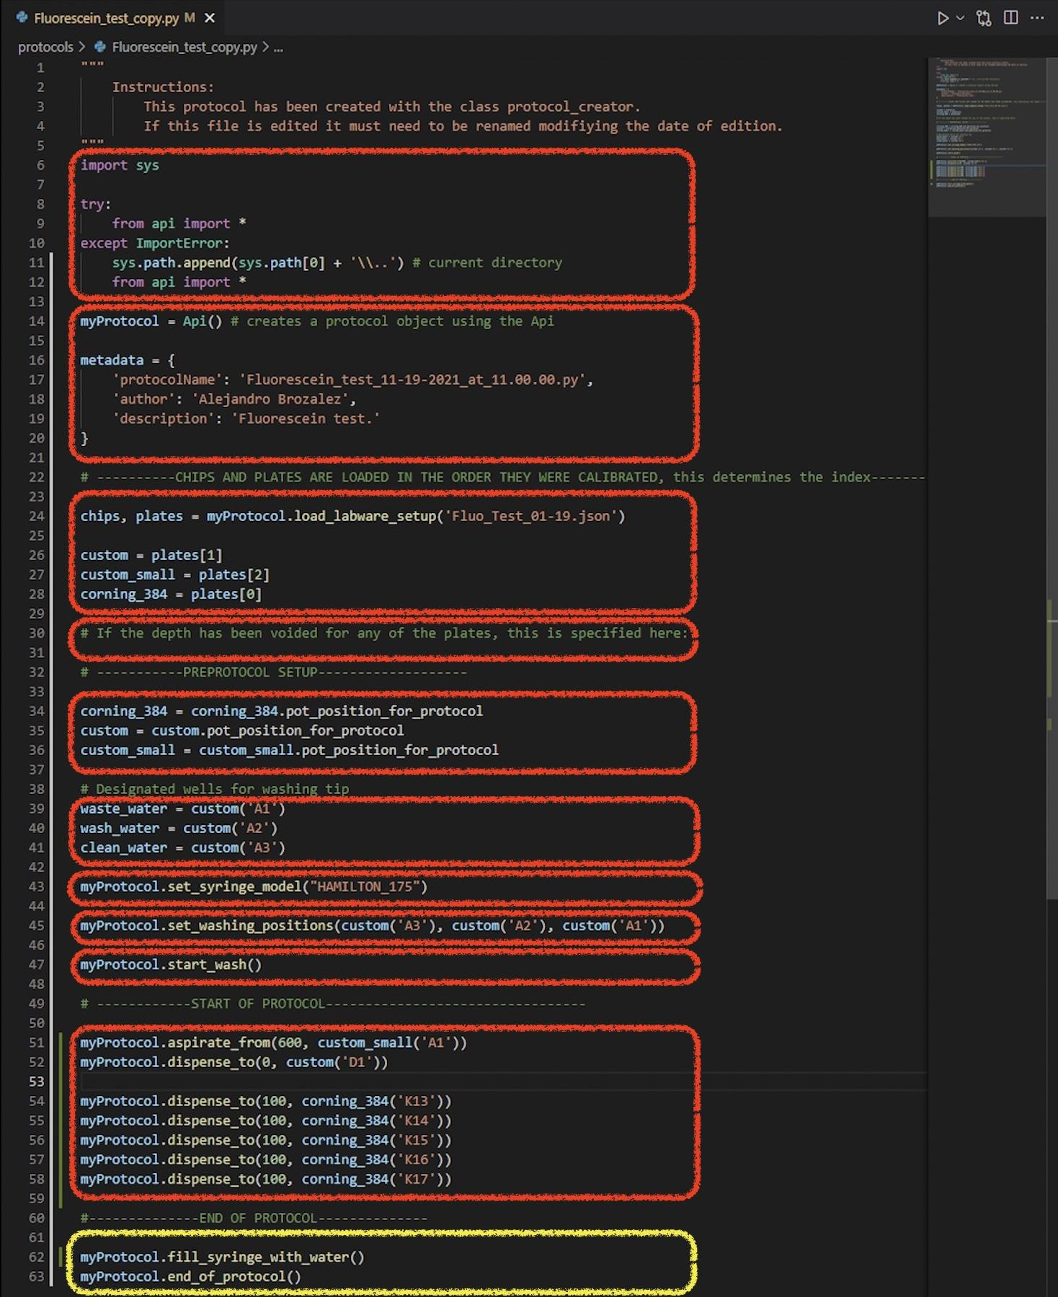
End of protocol
In order to keep water in the syringe so that it does not evaporate causing the next protocol run in a day or two to switch syringe, we fill the syringe with water, then we move the pipette to the 3rd slot so that it is out of the way.

Slide 24
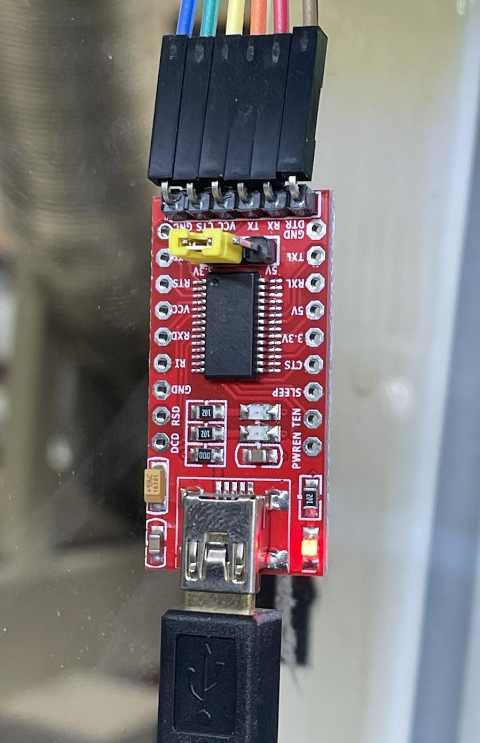
Robot-App interface
A USB to TTL (FT232RL) device is use to connect from the computer to the Smoothieboard through the Rx and Tx in the RasPi shield.
We need to connect:
Ground
Rx
Tx
**Since we use serial connection, it might be necessary to check the port name and input it manually, depending on the operating system used.

Slide 25
Robot-App interface
OTdriver.py
Opentrons
driver_3_0
coordinator.py
TDdriver.py
build_config
Flask
TCdriver.py
serial
web_app.py
Open-cv
Joystick.py
pygame
Subproces
Joystick_profile.py
python_execute.py
psutil
keyboard.py
protocol_creator.py
plate.py
deck.py
plate.py
constants.py
json
labware_class.py
chip.py
csv
Models_manager.py
video_stream.py
calibration.py

Slide 26
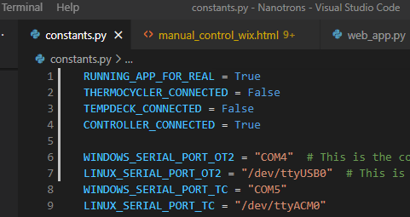
Running the app
In constants.py verify that the devices boolean variables are properly set.
Open web_app.py
Run it (play button)
Open a browser and type:
localhost:5000
Start navigating
Refer to the Nanotrons app slides

Slide 27
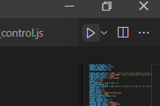
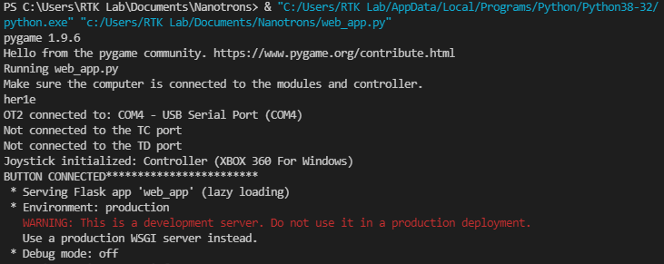
Running the app
In constants.py verify that the devices boolean variables are properly set.
Open web_app.py
Run it (play button)
Open a browser and type:
localhost:5000
Start navigating
Refer to the Nanotrons app slides

Slide 28
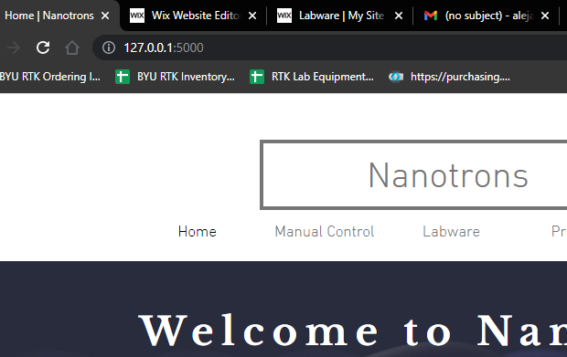
Running the app
In constants.py verify that the devices boolean variables are properly set.
Open web_app.py
Run it (play button)
Open a browser and type:
localhost:5000
Start navigating
Refer to the Nanotrons app slides

